Slide 1
CSAT Analysis Project
Call Performance and Service Insights
Name: Nikhil Kumar Reddy
Email:nikhilkumarreddy1354@gmail.com
Course: CDA
Batch:10th Nov

Slide 2
Motivation to choose dataset
I selected this dataset because it is practical, relevant, and easy to connect with real-world scenarios. It contains information that helps analyze customer satisfaction, service performance, and call handling efficiency. Working with this dataset allows me to apply SQL and data analysis skills to uncover meaningful insights that can improve business decisions.
It is easy to understand, useful for learning, and directly shows how data can solve real problems. It helps me practice queries, visualize results, and make recommendations that matter.

Slide 3
Process of doing project
Collect Dataset
Collected dataset from SQL database
Clean & Prepare Data
Removed duplicates, handled missing values, and formatted dates.
Analyze with SQL
Wrote queries to find total calls, calls by channel, SLA compliance, and top reasons.
Created some DAX queries for given data
Visualize Results
Built charts and dashboards (bar, donut, map, line graphs) for clear insights.
Interpret Findings
Identified trends: billing queries dominate, call‑center leads, SLA mostly met
Present Insights
Created a professional PPT with key findings, visuals, and recommendations

Slide 4
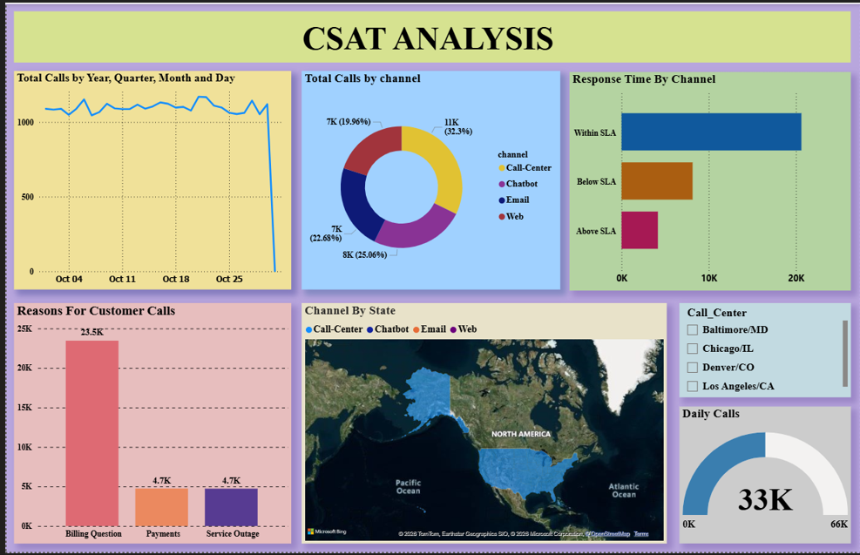

Slide 5
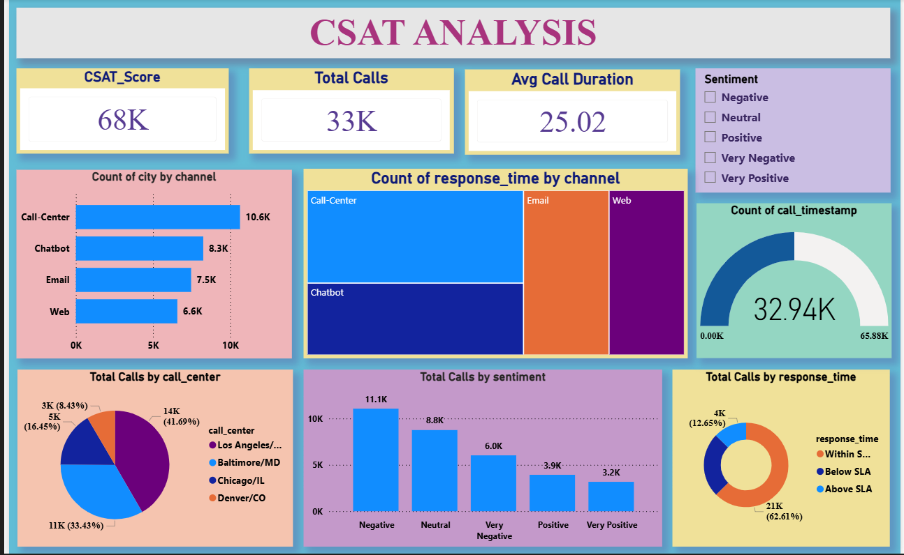

Slide 6
Key Insights
Overall CSAT Score: 68K — shows strong customer satisfaction levels.
Total Calls: 33K — indicates high customer engagement across channels.
Average Call Duration: 25 minutes — suggests detailed customer interactions.
Top Channel: Call‑Center (10.6K calls) — most preferred by customers.
Response Time: 63% of calls handled within SLA — good service efficiency.

Slide 7
Sentiment Analysis:
Majority of feedback is Negative (11.1K) and Neutral (8.8K).
Positive sentiments (3.9K + 3.2K) show room for improvement.
City‑wise Performance: Los Angeles leads with 14K calls (42%), followed by Baltimore (33%).
Channel Efficiency: Call‑Center and Chatbot handle most responses quickly.

Slide 8
Recommendations
Improve Customer Experience
Provide clear and quick resolutions through FAQs or self‑service portals.
Enhance Channel Efficiency
Strengthen Chatbot and Email response systems to handle more queries within SLA.
Offer training for call‑center agents to maintain consistency and empathy in communication.
Optimize Response Time
Monitor SLA performance regularly and set alerts for delayed responses.
Automate routine tasks to speed up resolution time.
Leverage Sentiment Analysis
Use sentiment data to identify pain points and improve customer interactions.
Target negative sentiment customers with personalized follow‑ups or offers. Focus on reducing negative feedback by addressing common issues like billing and payment queries.

Slide 9
Conclusion
The CSAT Analysis project highlights strong customer satisfaction overall, with most calls handled within SLA.
Call‑Center remains the most trusted channel, while Chatbot and Email need efficiency improvements.
Billing queries dominate customer concerns, showing the need for better self‑service and proactive communication.
Sentiment analysis reveals high negative and neutral feedback, pointing to opportunities for improving customer experience.
Geographic insights show Los Angeles as the busiest center, requiring balanced resource allocation.

